Slide 1


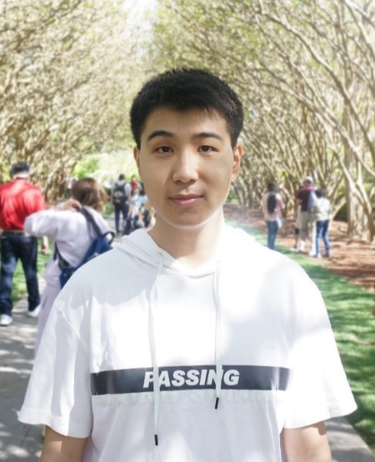

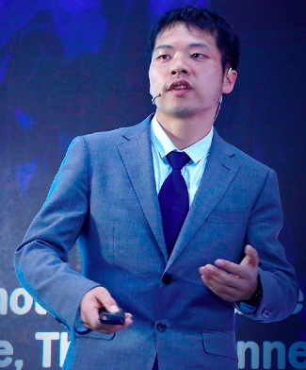

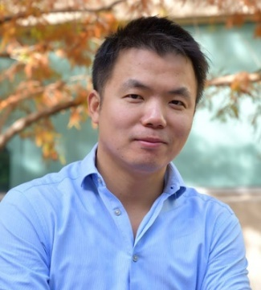
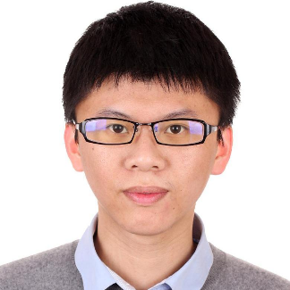
GLIB: Towards Automated Test Oracle for Graphically-Rich Applications
[ESEC/FSE’ 21]
Ke Chen*, Yufei Li*, Yingfeng Chen, Changjie Fan, Zhipeng Hu, Wei Yang
∗The first two authors contributed equally to this research.

Slide 2

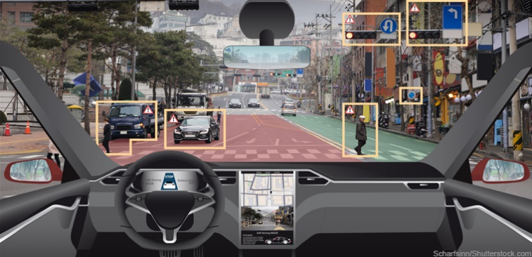
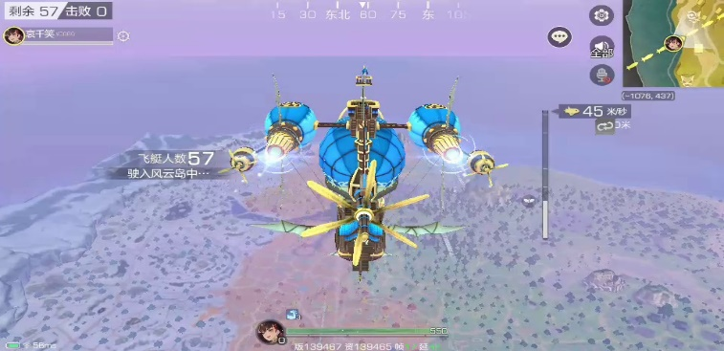
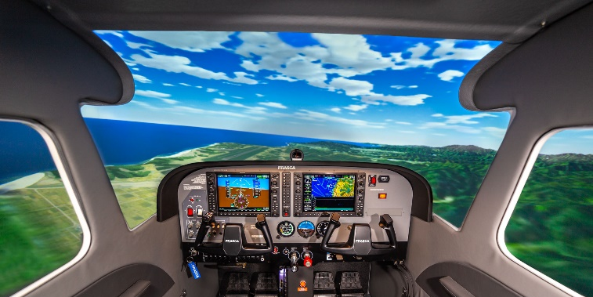
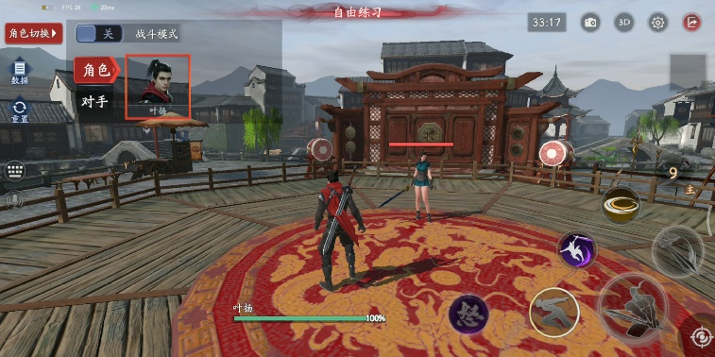
Testing Graphically-Rich Apps is Crucial Today
Simulators & Sensors
Games
Testing for Safety
Testing for Quality
User interface (UI) testing for graphically-rich apps is in need

Slide 3
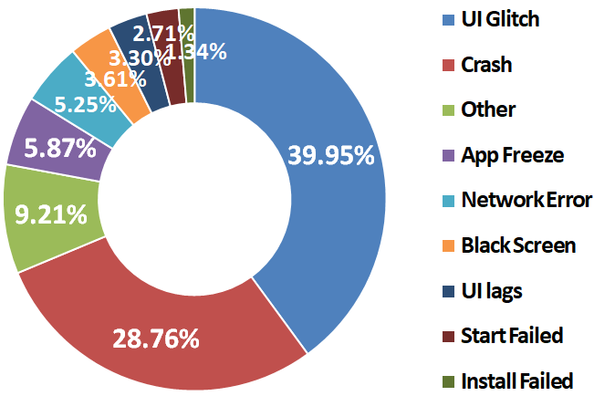
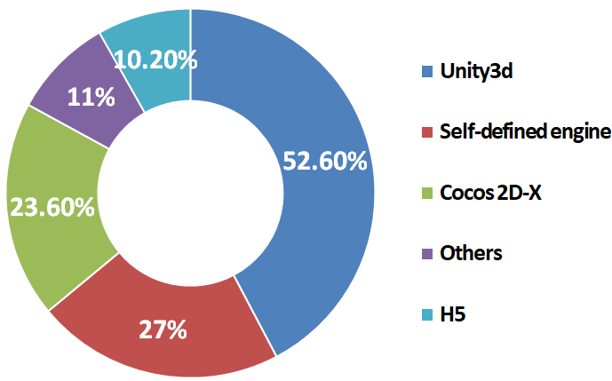
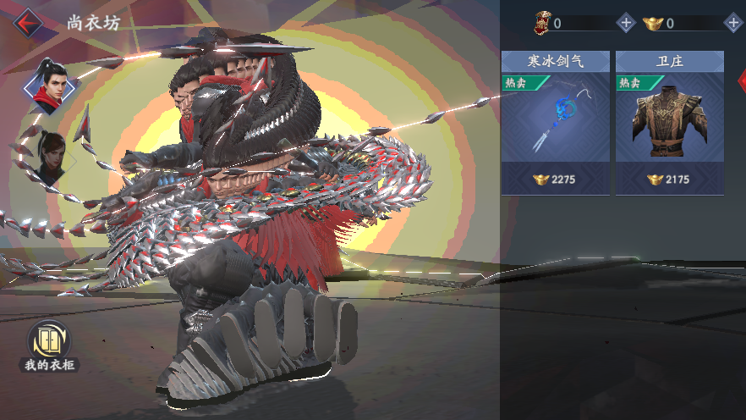
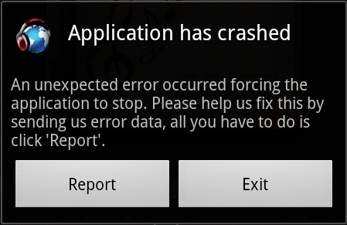
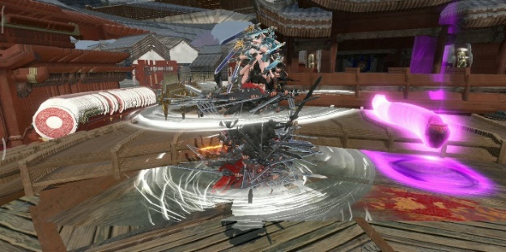
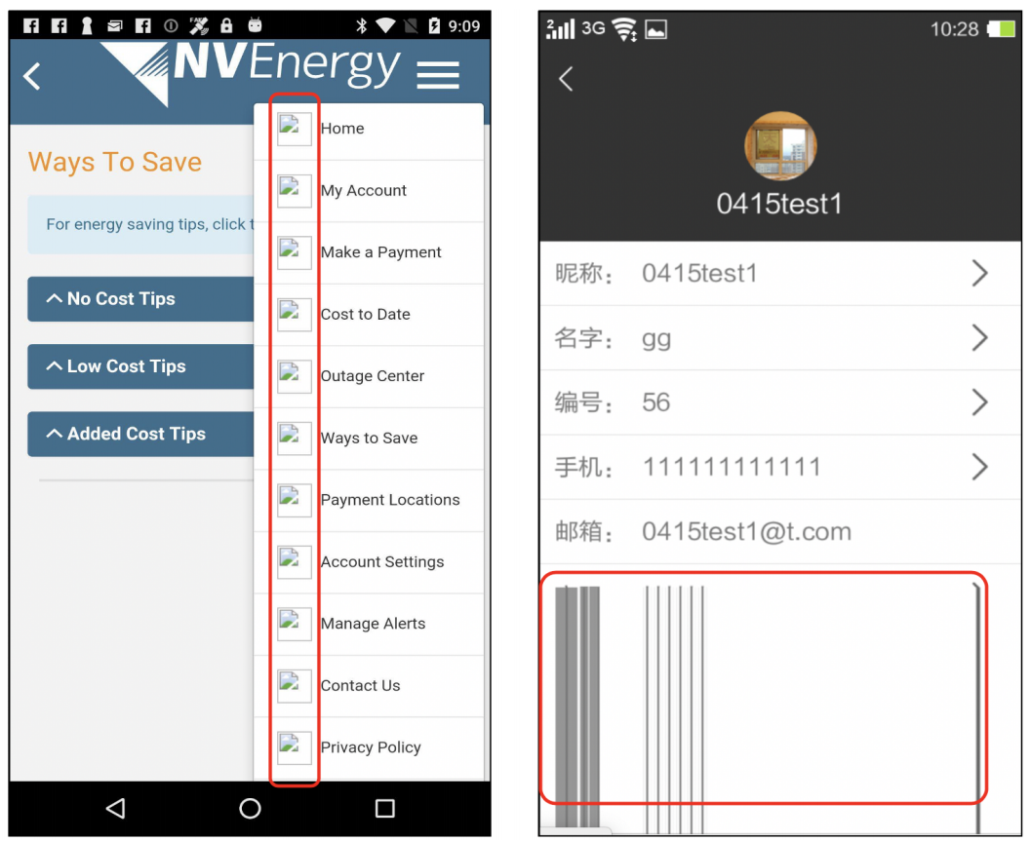
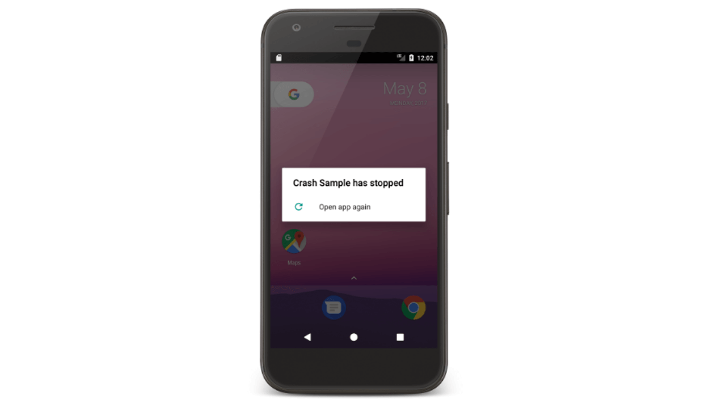
Game UI Testing is Different from Other App Testing
UI Glitches are Common Mobile Game Issues
UI Glitches in Games are Severe
Most UI Glitches are Not Crash-Inducing
UI glitches in game apps
Common issues in other apps
UI glitch detection is required for game apps

Slide 4
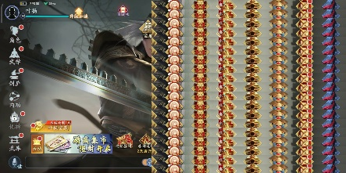
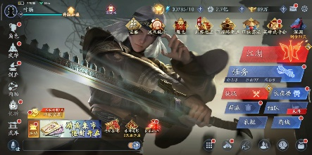
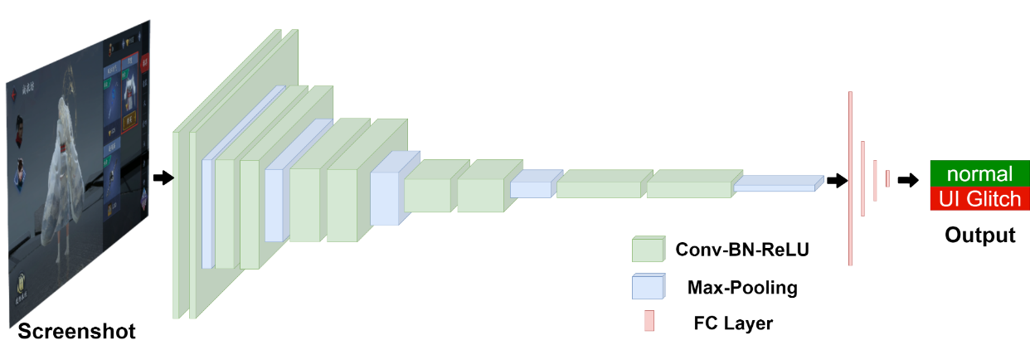
Existing Testing Work Cannot Handle Game UI Glitches
Existing UI Testing Architecture
Wuji
Generate
Test Cases
App execute
Crash
Report
Bugs
How to detect those Non-crash-inducing bugs such as UI glitches?
Feature extraction + Decision making
UI glitch images
Feature-based game UI test oracle
Normal Images
How to extract features and make reliable decisions?

Slide 5

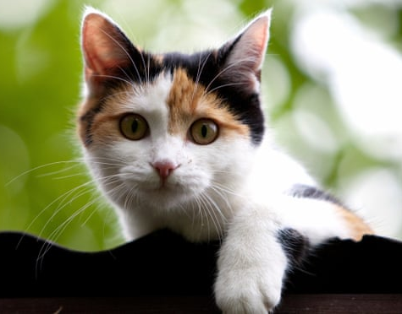

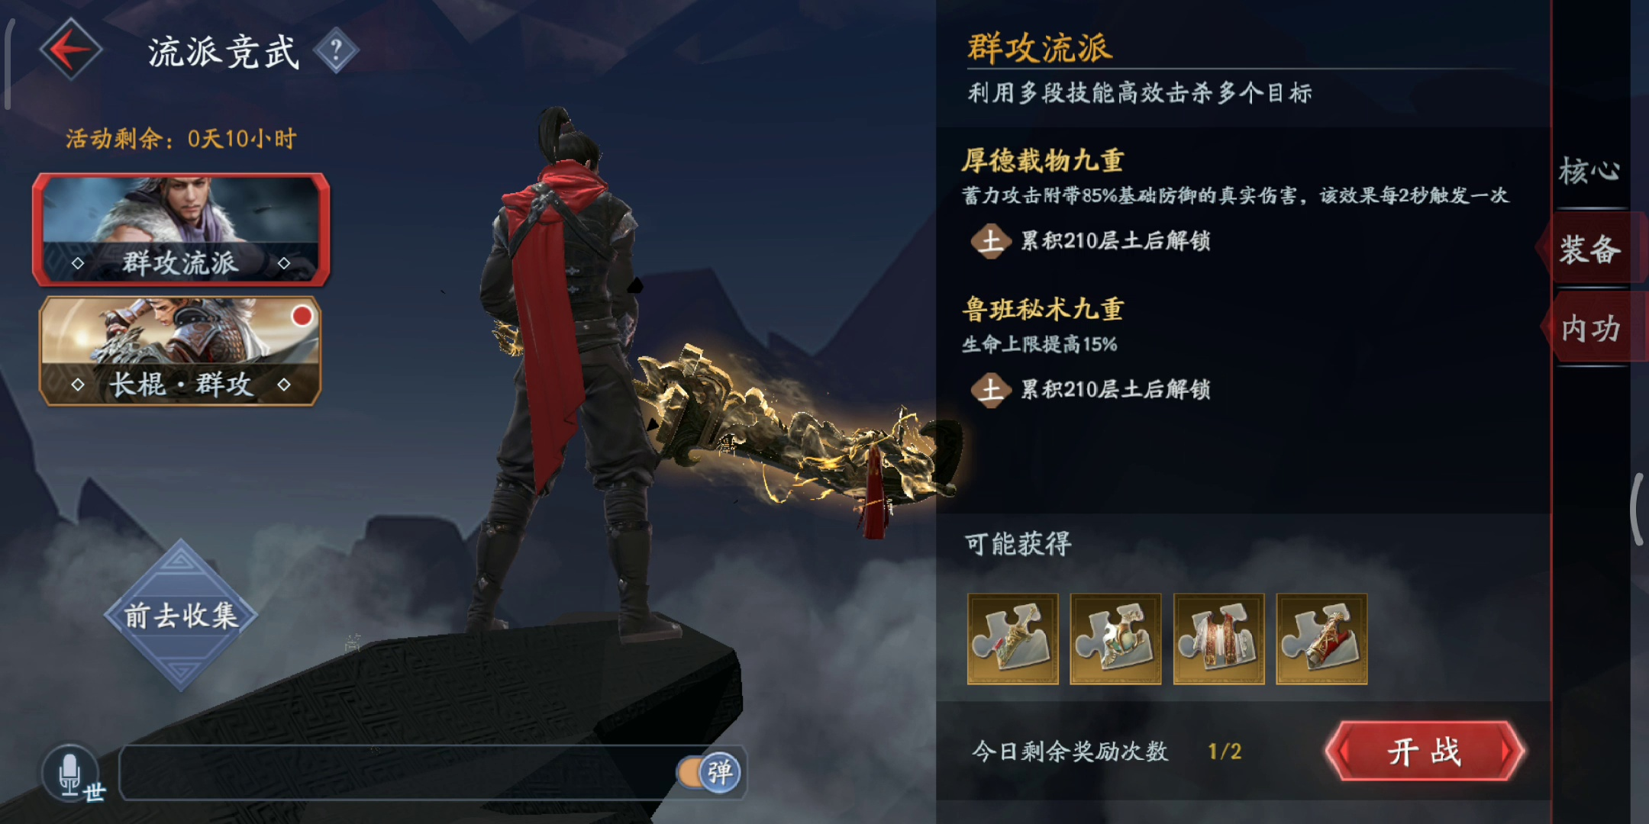
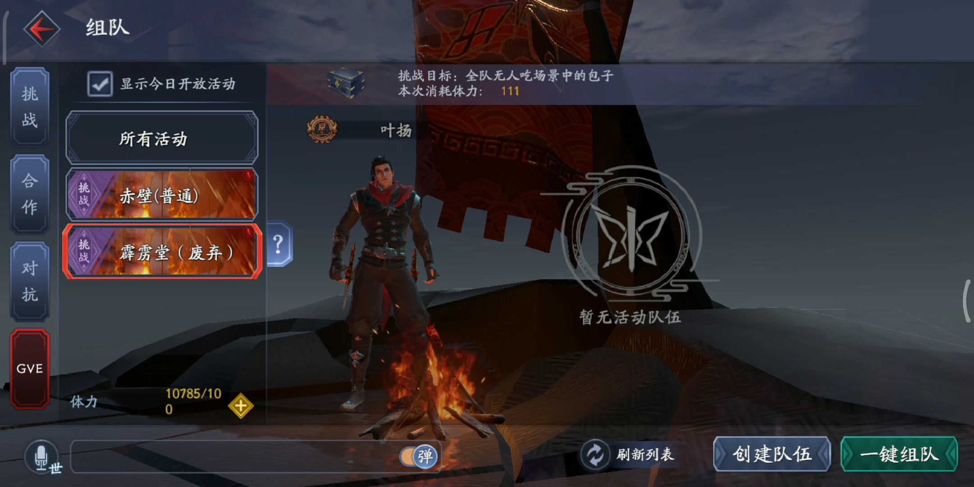
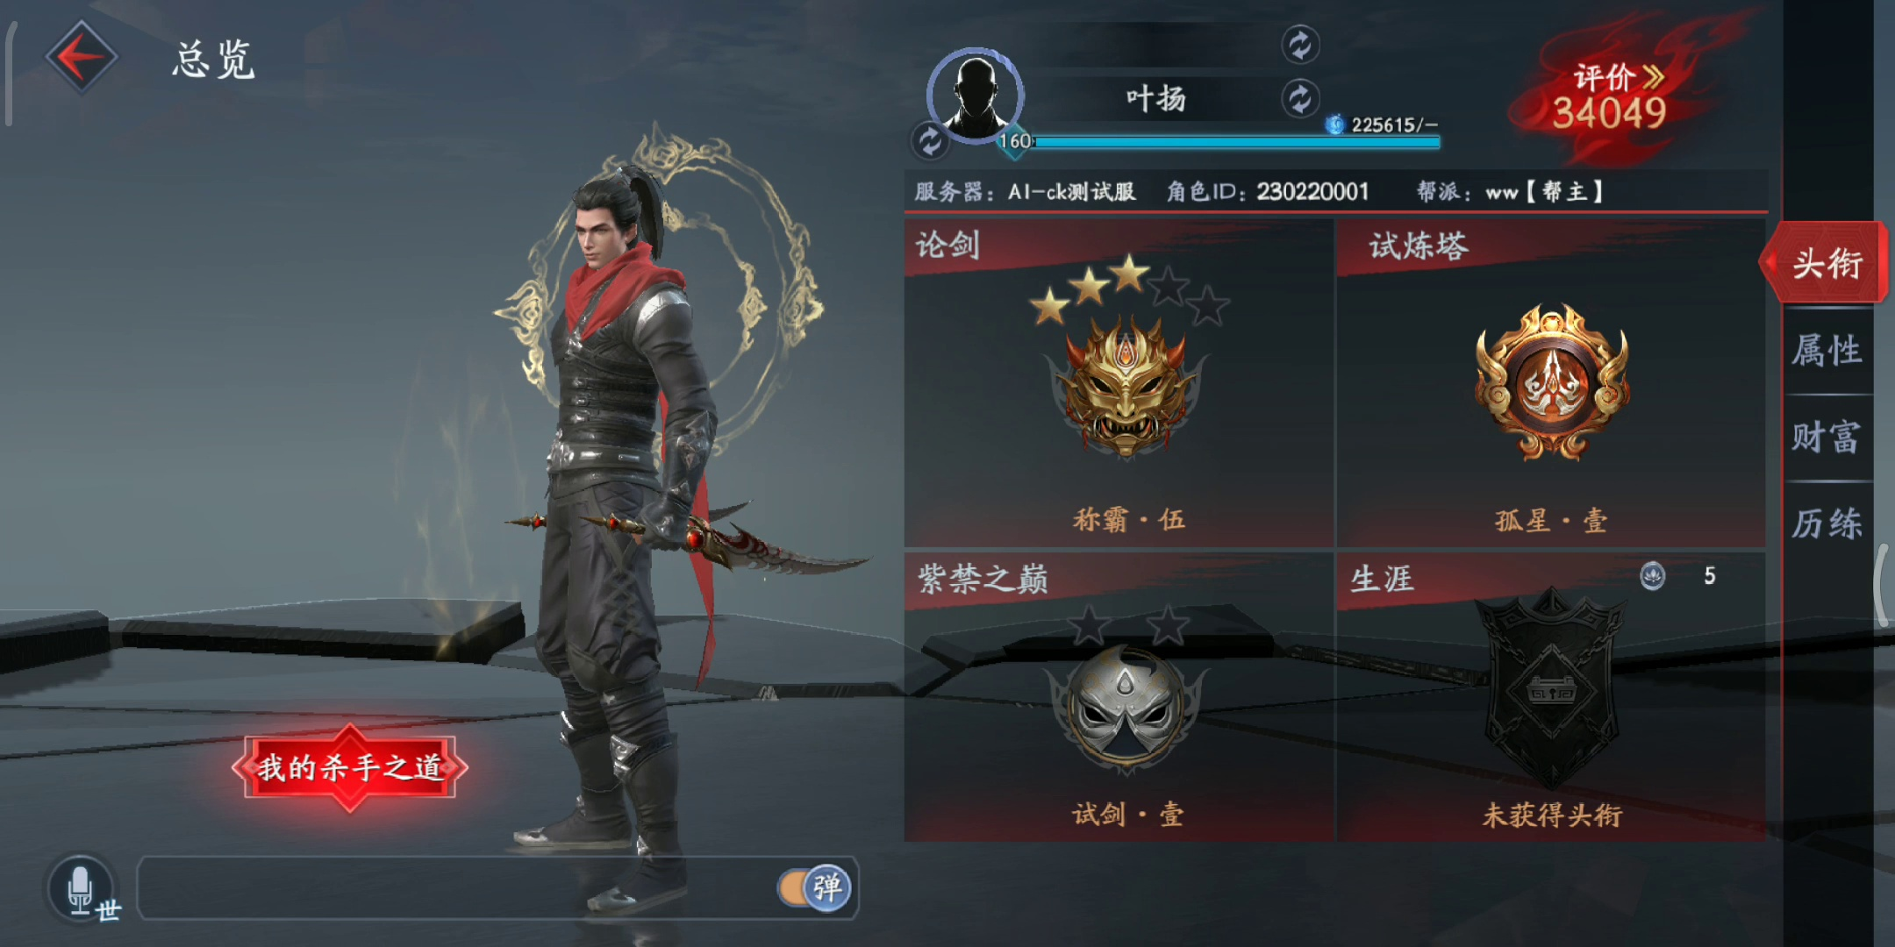
CNNs are Powerful for Visual Understanding
Image Input
Feature Extraction
Decision Making
90% dog
10% cat
UI Glitch Detection
70% cat
Classification
30% dog
mobile game
IO module
High reliability premise: large dataset training for DNN
scene traverse
Problem: real-world game screenshots contains few glitch images?
Solution (data augmentation): generating enough real-world UI glitches

Slide 6



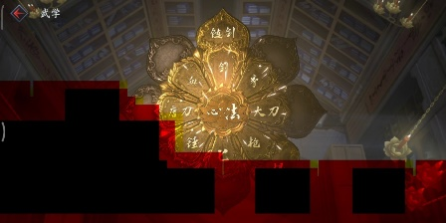
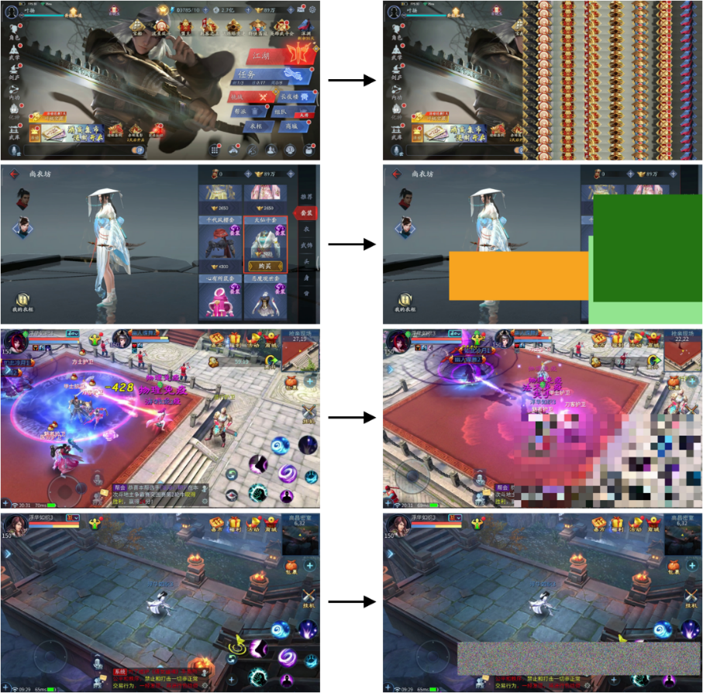
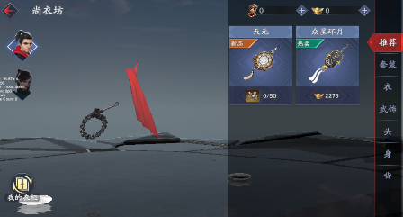
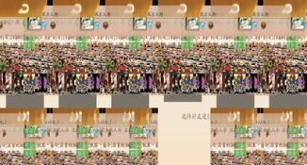
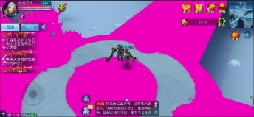
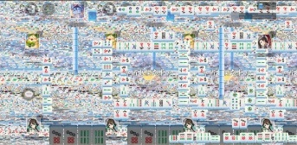
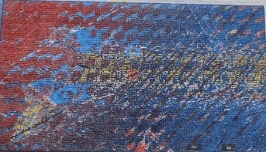
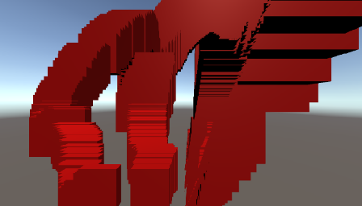
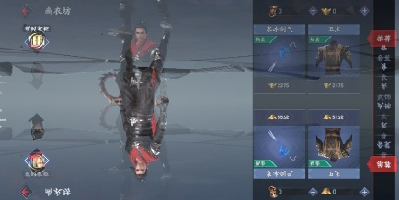
Generating Real-World UI Glitch Images
Challenge: How to generate large amount of real-world UI glitch images?
Existing data augmentation approach: Heuristic-based & Not graphically-rich specific
Are these generated samples representative?
UI glitch type
normal images
abnormal samples
rule1
UI glitch samples
rule2
manifestation study
rule3
rule4

Slide 7

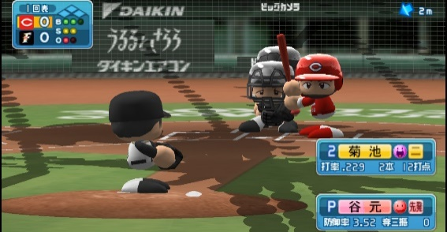
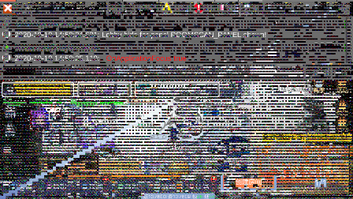
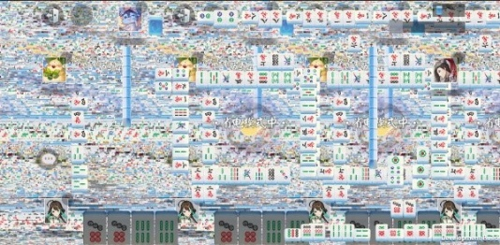
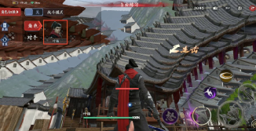
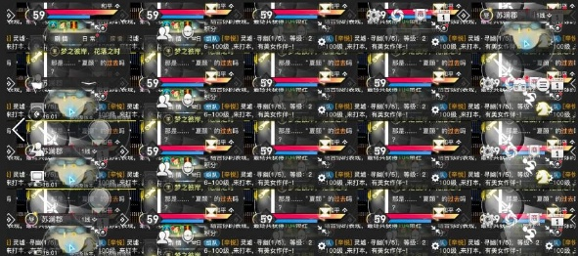
Generating Real-World UI Glitch Images
Our approach: code-based data augmentation.
Hard to be summarized to rules!
UI glitch type
generated images
Bug Injection
bug1
bug2
UI glitch samples
manifestation study
bug3
bug4
bug5

Slide 8
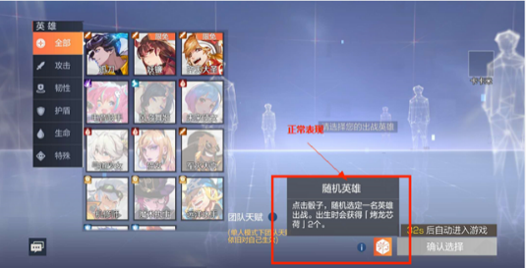
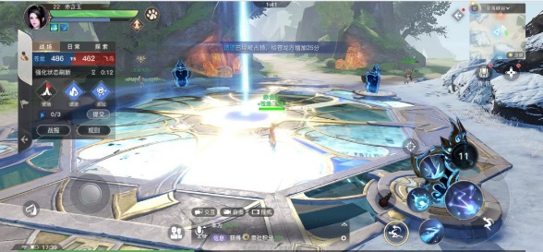
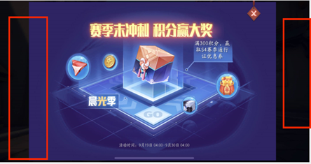
Game UI Glitch Manifestation Study
(a) Abnormal color block
(b) Random noise
(c) Partial repetition
(d) Frame overlay
(e) Object missing
(f) Abnormal text
(g) Overexposed
(h) Black border

Slide 9
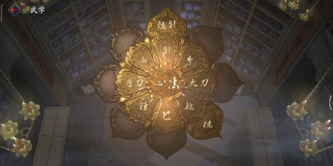
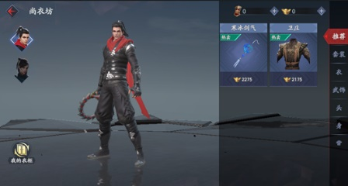
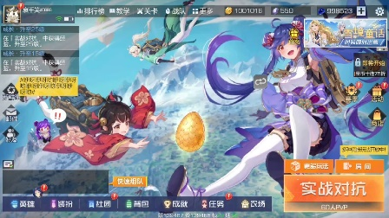
UI Bug Understanding: Camera Enable Error
Motivation: generate glitchy images by injecting real bugs into the applications.
Focus: Unity3d engine-based mobile apps.
original scene
UI glitch scene
abnormal color block
1
2 +
3
4
5
6
7
targetCamera.targetTexture = originRT;
targetCamera.enabled = true;
if (UIManager.inst != null && UIManager.inst.uiCamera!= null)
(
UIManager.inst.uiCamera.enabled = true;
)
object missing
Listing1: Bug of rendering camera enable error.
random noise

Slide 10
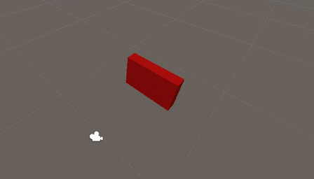
UI Bug Understanding: Camera Clearflag Error
Motivation: Learn how UI glitches occur from code perspective, then we can generate real UI glitch images.
Focus: Unity3d engine-based mobile apps.
1
2
3
4
5
6
7
8
9
10
11
12
13 +
14
15
16
var originRT = targetCamera.targetTexture;
targetCamera.targetTexture = rt;
targetCamera.Render ();
CameraPostEffect.instance.doPostEffects(rt , postRT);
if (UIManager.inst != null && UIManager.inst.uiCamera != null)
{
if (uiCameraOn)
{
UIManager.inst.uiCamera.Render ();
var originUIRT = UIManager.inst.uiCamera.targetTexture;
UIManager.inst.uiCamera.targetTexture = postRT;
UIManager.inst.uiCamera.Render ();
UIManager.inst.uiCamera.clearFlags = CameraClearFlags.Depth;
UIManager.inst.uiCamera.targetTexture = originUIRT;
}
}
original scene
UI glitch scene
frame overlay
Listing2: Wrong settings of camera clearflag error.

Slide 11

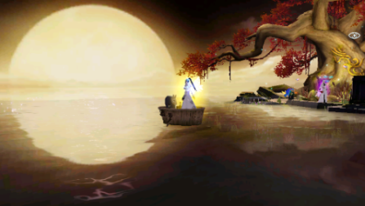
UI Bug Understanding: Camera Post-Processing Error
Motivation: Learn how UI glitches occur from code perspective, then we can generate real UI glitch images.
Focus: Unity3d engine-based mobile apps.
1
2
3
4
5
6
7
8
9
10 +
11
private static LuaFunction m_hookOnDisable = null;
private void OnDisable () {
if (m_hookOnDisable != null) {
if (GameBaseObject.Inst.InvokeNewHook(m_hookOnDisable , this)) return; }
if (CameraPostEffect.instance == null || image.texture == null)
{
return;
}
CameraPostEffect.instance.ReleaseUIBloomTarget ();
CameraPostEffect.instance.ClearPostRenderRT ();
}
original scene
UI glitch scene
partial repetition
Listing3: Incorrect camera post-processing effect error.

Slide 12






Our Approach: Hotfix Bug Injection
mobile game
program crash
program updated
UI glitch
bug
raw bug
patch code
inject
wrap
inject
Problem1: How to promise only UI-related issues happen after bug injection?
We wrap the bug code with execution parameter settings (patch code) so that the execution program could get updated to the bug-injected version.
Problem2: How to generalize our approach to other games and platforms?
Unity interface
Only change global variables / functions (no need for authority of game source program)
…
camera.enabled = true
…
…
private …
private …
private …
…
…
camera.enabled = false
…
…
private …
private …
private …
…
patch code
program updated
UI glitch
execution server
push
…
inject

Slide 13
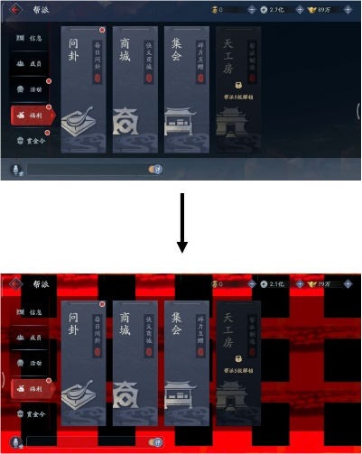
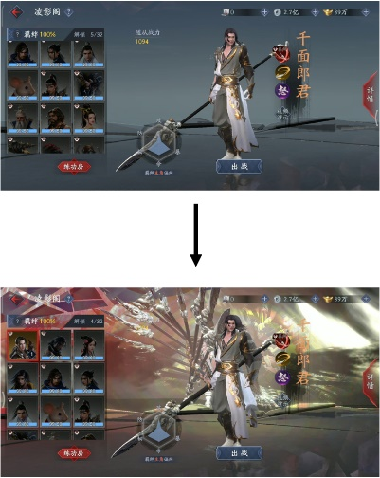
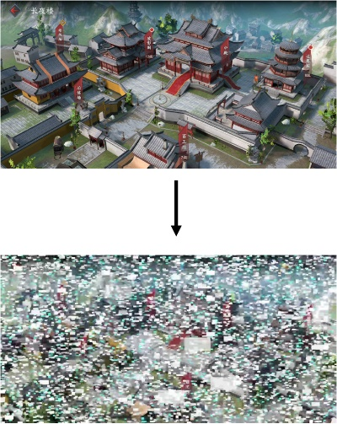
Code Injection Details
Camera Turned Off
Incorrect Camera Clearflag
Incorrect Post-Processing
1
2
3
4
5
local cameraobjs = CS.UnityEngine.Object.FindObjectsOfType(typeof(CS.UnityEngine.Camera))
for i = 0, cameraobjs.Length -1
do
cameraobjs[i].enabled = false
end
1
2
3
4
5
local cameraobjs = CS.UnityEngine.Object.FindObjectsOfType(typeof(CS.UnityEngine.Camera))
for i = 0, cameraobjs.Length -1
do
cameraobjs[i].clearFlags=UnityEngine.CameraClearFlags.DepthOnly
end
1
2
3
4
5
local detectCamera = GameObject.Find("UICamera")
if (detectCamera ~= nil)
then detectCamera.gameObject:AddComponent(typeof(CameraFilterPack_3D_Mirror))
end
Listing4: Lua patch for turning off all cameras.
Listing6: Lua patch for adding mirror post-processing effect to current scene.
Listing5: Lua patch for changing clearflag as DepthOnly for all existing cameras in the scene.

Slide 14
Evaluation
Research Questions:
RQ1. How effective is GLIB in detecting game UI glitches?
RQ2. How well does GLIB perform in real-world game apps?
Experiment Setup (RQ1):
Datasets and DL model
Comparison baselines (Base, Rule, Rule+Code)
Train Data Augmentation Details
Train Dataset
Model Parameter
Data Type | Approach | Game1 | Game2
Normal | Base | 1654 | 6186
Glitch |  | 47 | 85
Rule | Partial Repetition | 1654 | 6186
 | Solid Color Block | 1654 | 6186
 | Mosaic Effect | 1654 | 6186
 | Random Noise | 1654 | 6186
Code | Camera Turned Off | 1506 | 3056
 | Incorrect Camera Clearflag | 3144 | 1076
 | Incorrect Post-Processing | 330 | 300
Approach | Glitch | Normal | Total
Base | 132 | 7117 | 7249
Rule | 7600 | 7600 | 15200
Code | 7600 | 7600 | 15200
Rule+Code | 15200 | 15200 | 30400
Layer Type | Layer | # Kernels | Activation
Convolutional (3 x 3) Batch Norm | 1~4 | 16 | ReLU
 | 5~6 | 32
 | 7~8 | 64
 | 9~10 | 128
MaxPooling | 11~15 | --
Fully Connected | 16~19 | --
Test Dataset
Glitch | Normal | Total
192 | 240 | 432

Slide 15
Evaluation
Evaluation Metrics (RQ1):
Precision
Recall
F1
Accuracy
Our adapted rule-based UI glitch generation
normal images
abnormal samples
partial repetition
Evaluation Results
Approach | Precision | Recall | F1 | Accuracy
Base | 0.991 | 0.563 | 0.718 | 0.803
Rule(R) | 0.935 | 0.677 | 0.785 | 0.836
Rule(F) | 0.974 | 0.594 | 0.738 | 0.813
Code+Rule(R) | 0.990 | 0.984 | 0.987 | 0.988
Code+Rule(F) | 0.995 | 0.948 | 0.971 | 0.975
Code (GLIB) | 1.000 | 0.990 | 0.997 | 0.998
abnormal color block
adding mosaic effect
adding random noise

Slide 16
Evaluation
Experiment Setup (RQ2):
Datasets
Evaluation Metrics (RQ2):
# detected issues
# confirmed issues
Game App Source
Evaluation Results
Game Name | Game Category | Source | Daily Active Users | Download
Justice | Role-Playing | Official Web | 300K+ | 50M+
A Chinese Ghost Story | Role-Playing | Official Web | 300K+ | 50M+
Ghost | Role-Playing | TapTap | 700K+ | 100M+
Revelation Mobile | Role-Playing | TapTap | 500K+ | 10M+
Love is Justice | Love | TapTap | 50K+ | 5M+
UNO | Card | App Store | 50K+ | 5M+
Fever Basketball | MOBA | App Store | 5K+ | 5M+
Marvel Duel | Card | TapTap | 5K+ | 500K+
Oracle Civilization | Simulation | App Store | 1k+ | 100k+
Ghost World Chronicle | Card | Develop Team | N/A | N/A
Elysium Of Legends | Card | Develop Team | N/A | N/A
phase10 | Card | Develop Team | N/A | N/A
Fpus | Shooting | Develop Team | N/A | N/A
The Absolute Acting | Simulation | Develop Team | N/A | N/A
Platform | GLIB | Rule(R) | Rule(F)
PC | 7 | 3 | 1
Android | 35 | 22 | 15
iOS | 11 | 6 | 5
Total | 53 (48 confirmed) | 31 (28 confirmed) | 21 (17 confirmed)

Slide 17
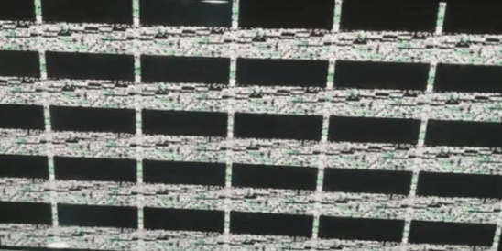
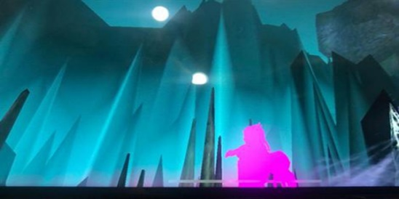
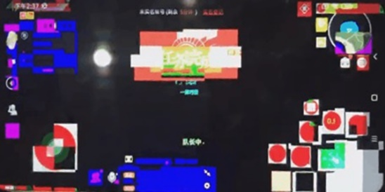





Case Study
Localize the UI glitch area:
Approach: Saliency Map (where I is an input image)
$$P\left(y=c | x\right)=\frac{e^{f_{e}(x)}}{\sum_{k=1}^{K}{e^{f_{k}(x)}}}$$
$$\frac{∂f(I)}{∂I}$$
Results

Slide 18
Contribution and Conclusion
Systematically investigate UI glitches and propose a framework for solving UI issues in real-world graphically-rich apps.
Create a large-scale dataset of UI glitchy screenshots and release the data for follow-up studies.
Propose a code-based data augmentation approach that can be applied in real-world game testing tasks and guide developers to find and fix the bugs.
Propose a CNN-based model for detecting images with UI display issues, and leverage saliency maps to localize the glitch region in the UI.
An approach, GLIB, is powerful for detecting UI glitches in graphically-rich apps.
UI glitches are different from other UI display issues, they are common and versatile on graphically-rich apps.
Two evaluations on more than 20 real-world games demonstrate the effectiveness of our approach.
Finding: Data containing representative features can boost the performance of DL models.

